Slide 1
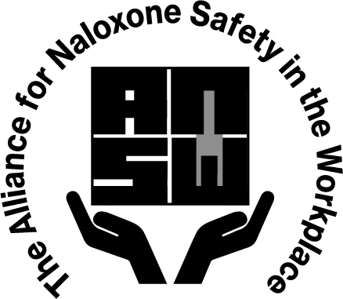
Naloxone Awareness Training

Slide 2
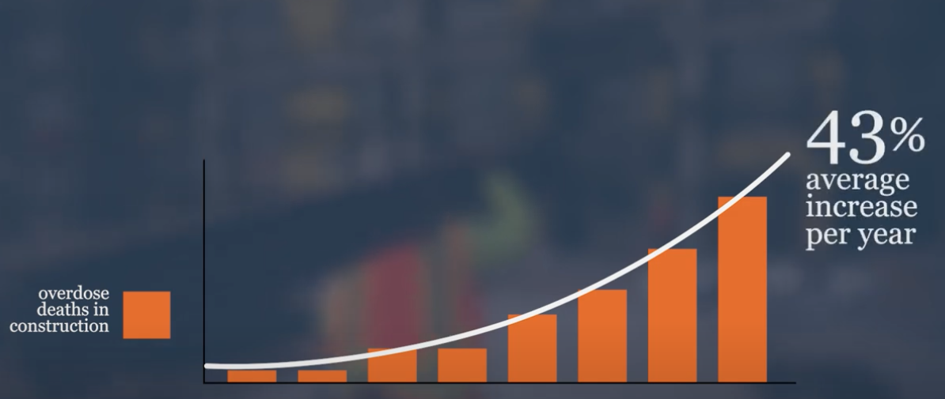
Opioid Crisis in Construction
Construction workers are five times more likely to have an overdose than people working in other industries.
Between 2010 and 2016 the number of overdose deaths among construction workers went up!

Slide 3
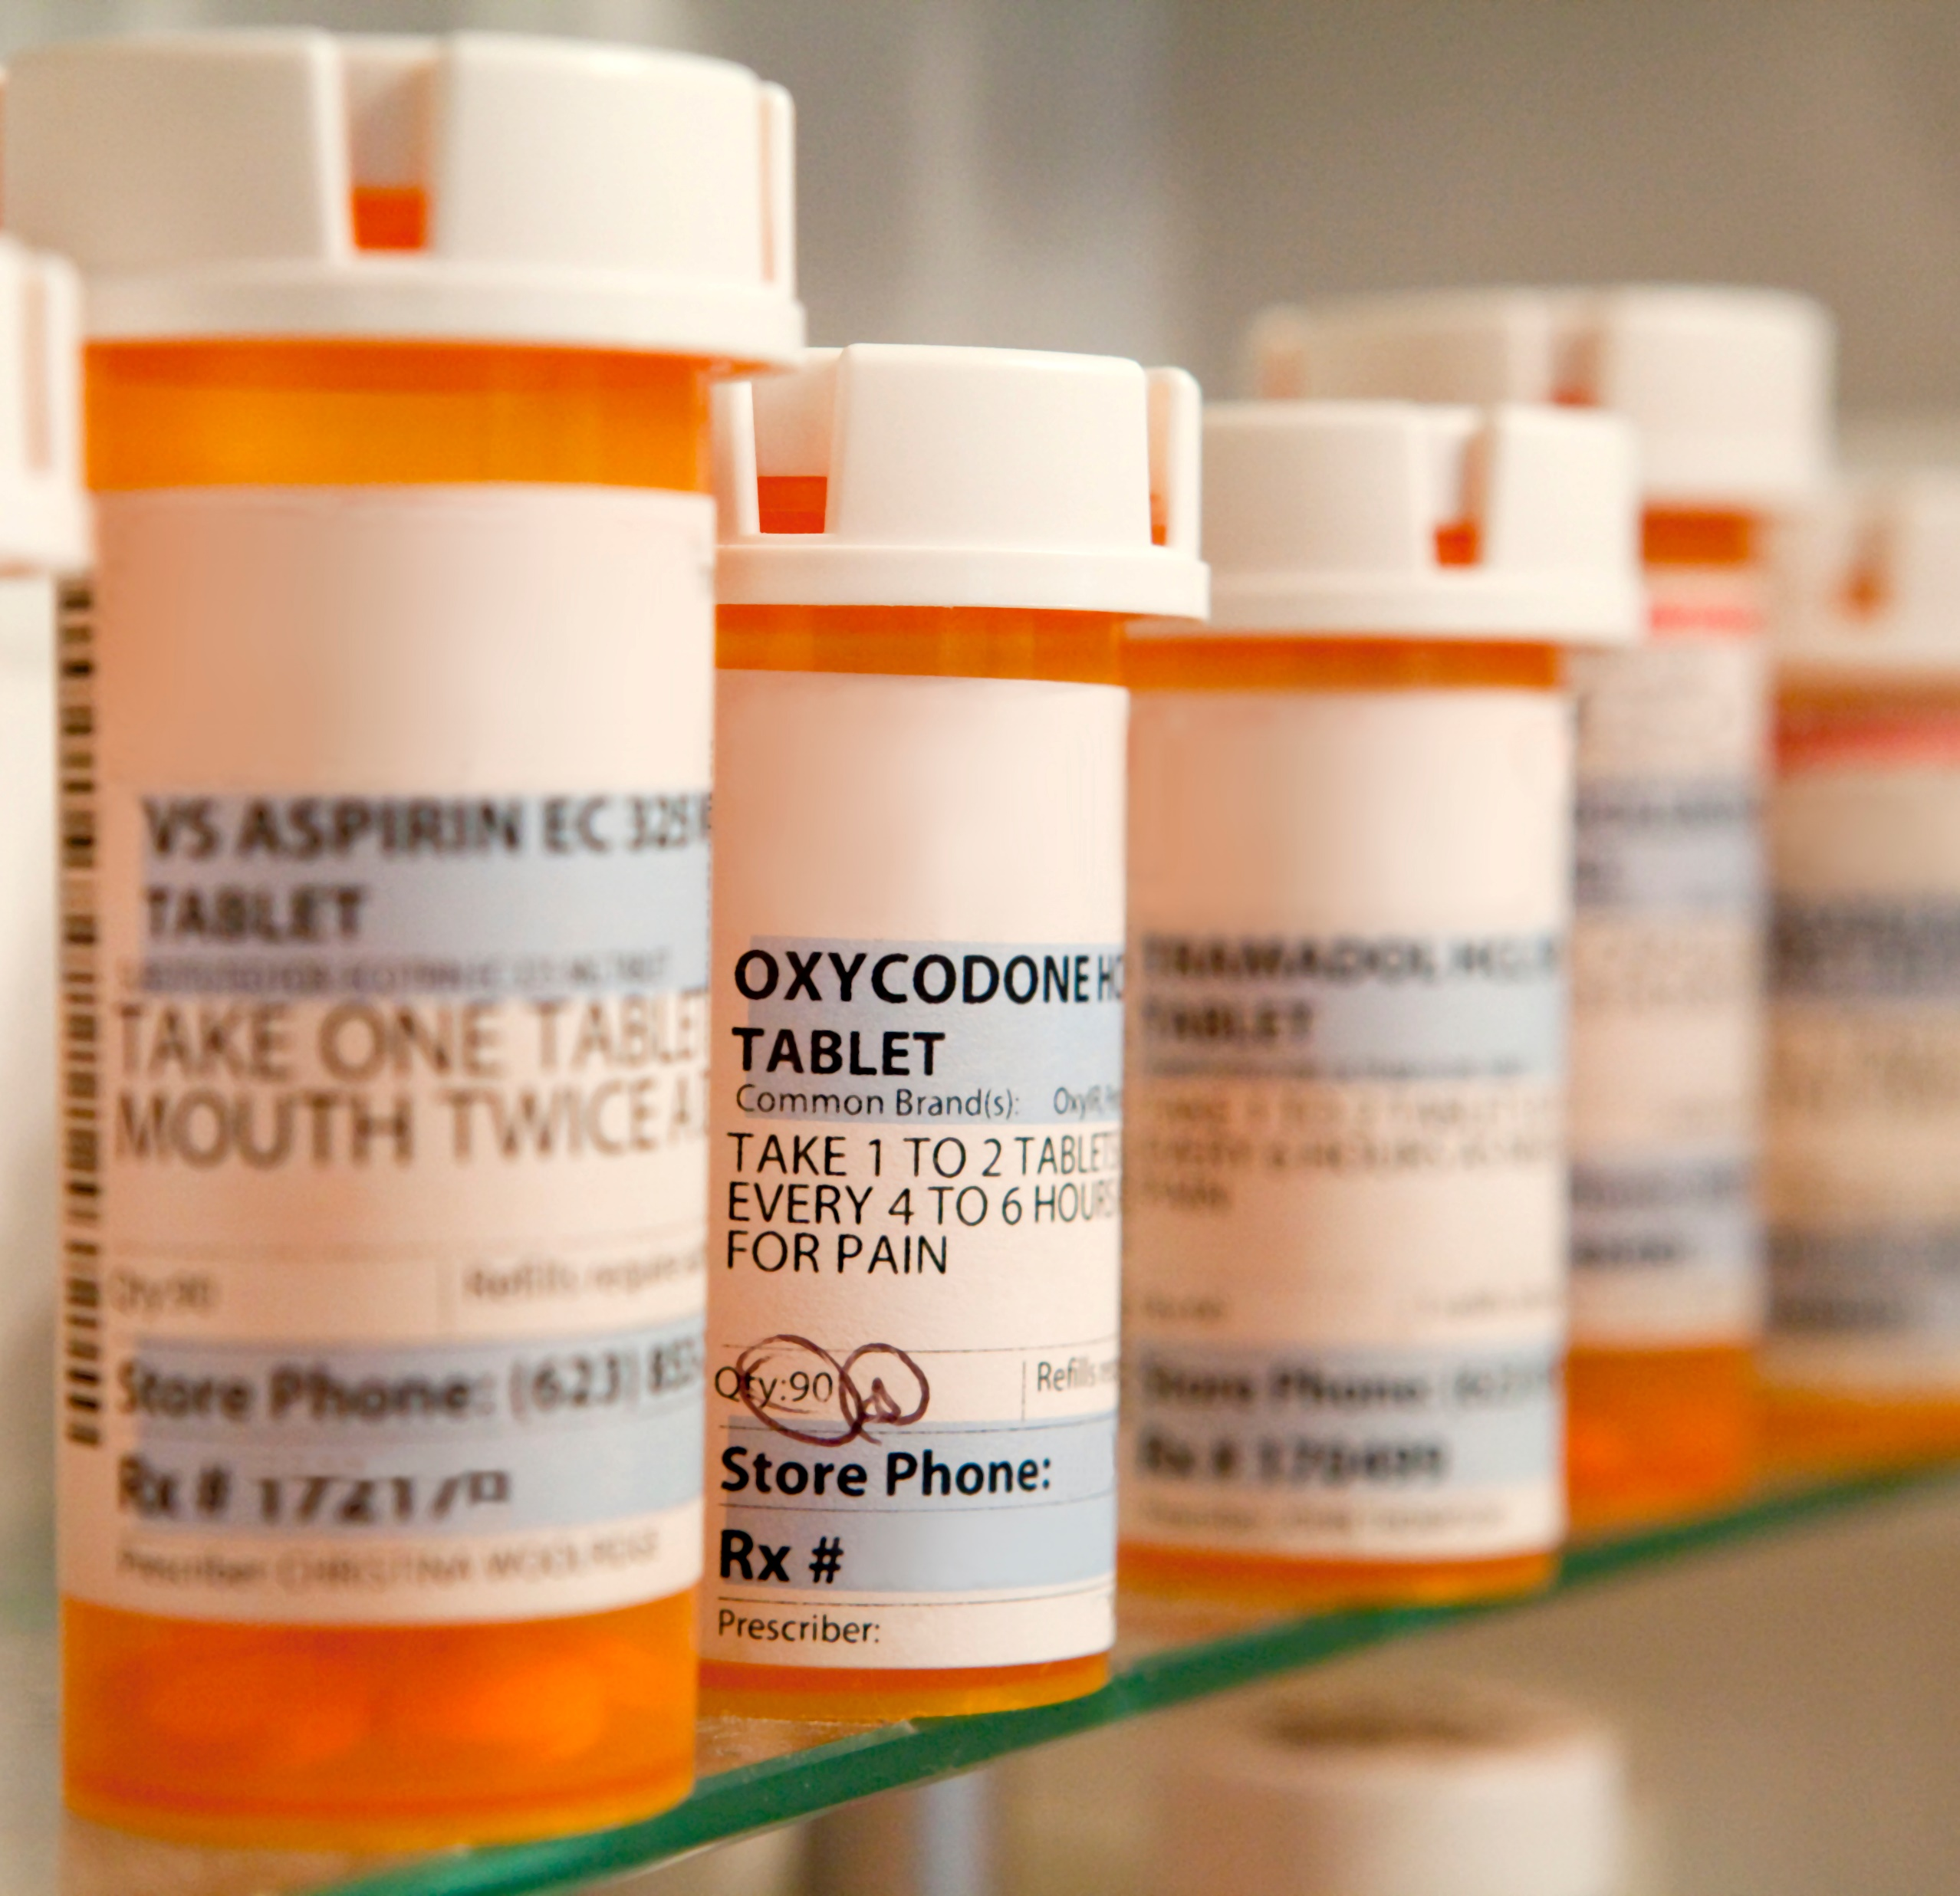
Why are construction workers at risk?
Almost a quarter of all overdose deaths in construction involve legal prescription painkillers given by doctors to help with pain.
Construction work can be tough on our bodies, causing pain from injuries or just hard work. Doctors sometimes prescribe strong painkillers like OxyContin or Vicodin. But these medicines are dangerous if not used correctly.

Slide 4
How can prevent opioid use?
Create a pain management plan with your medical provider.
1
Request non-addictive pain medications.
2
Request physical therapy/massage therapy or chiropractor
3

Slide 5
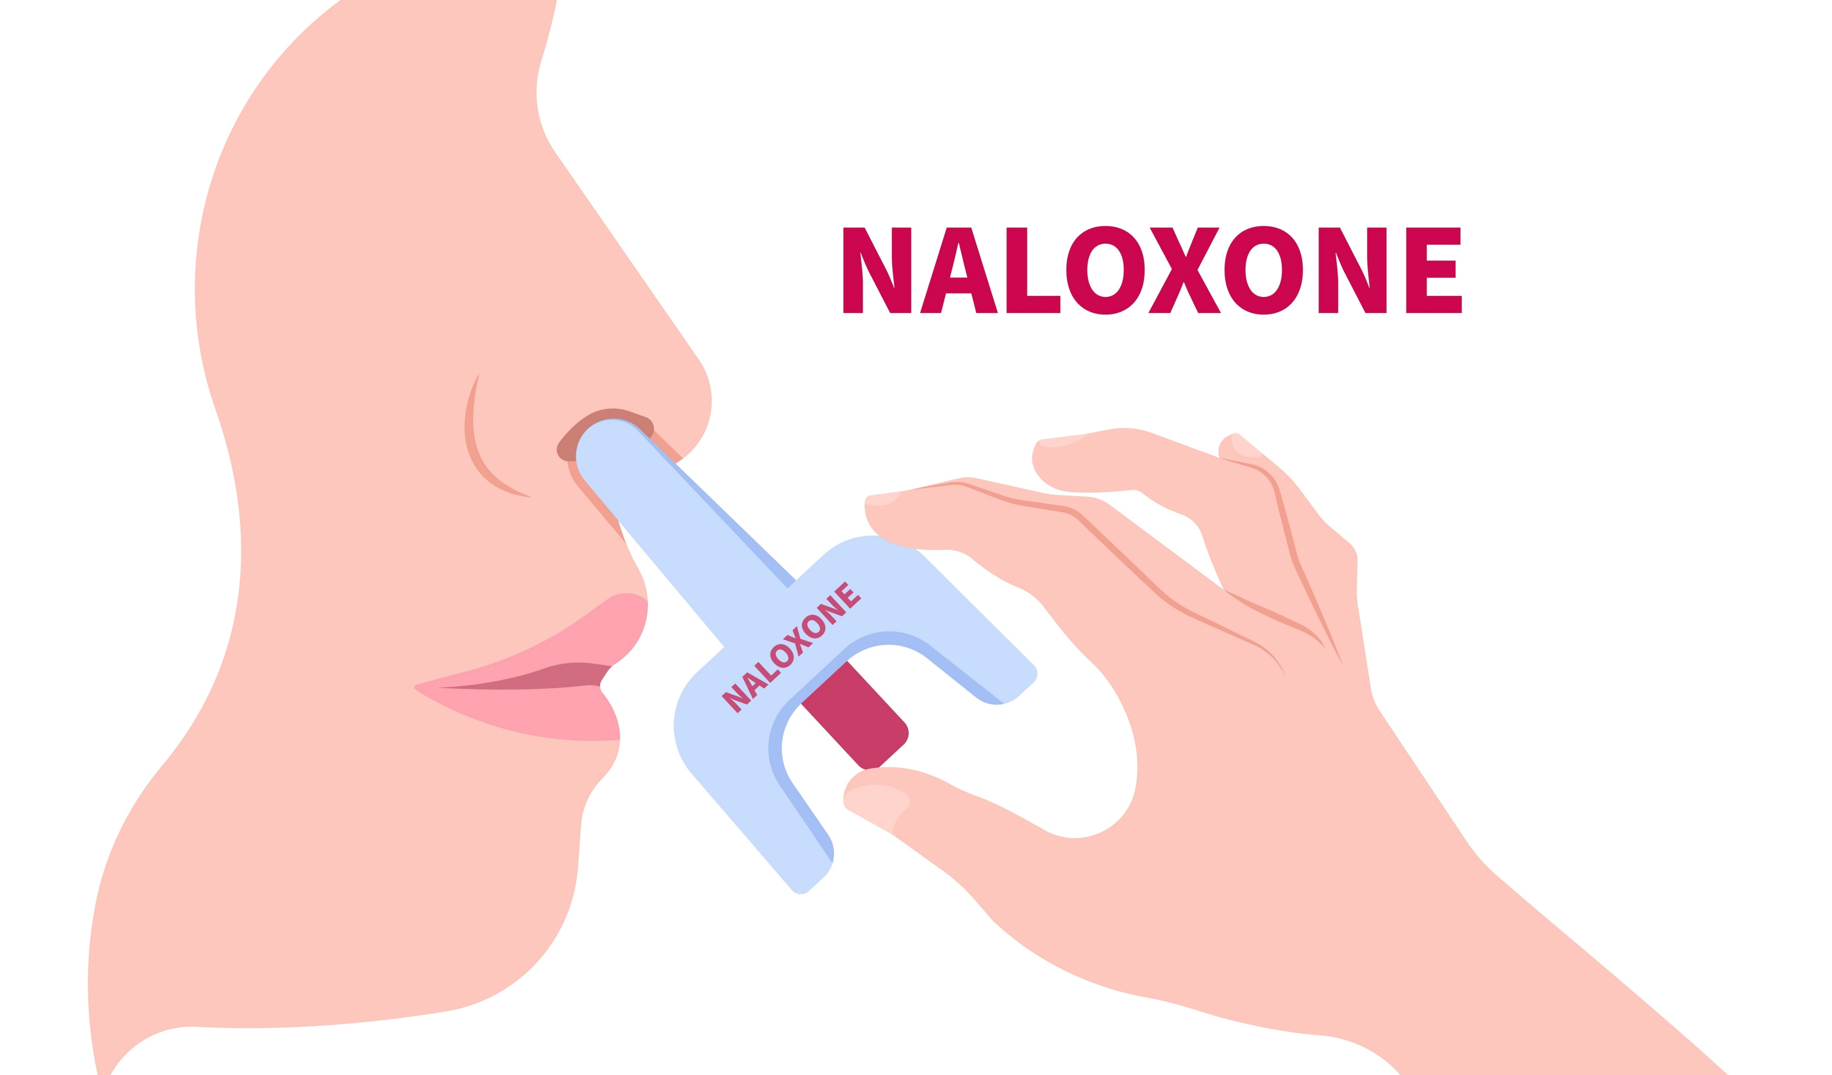
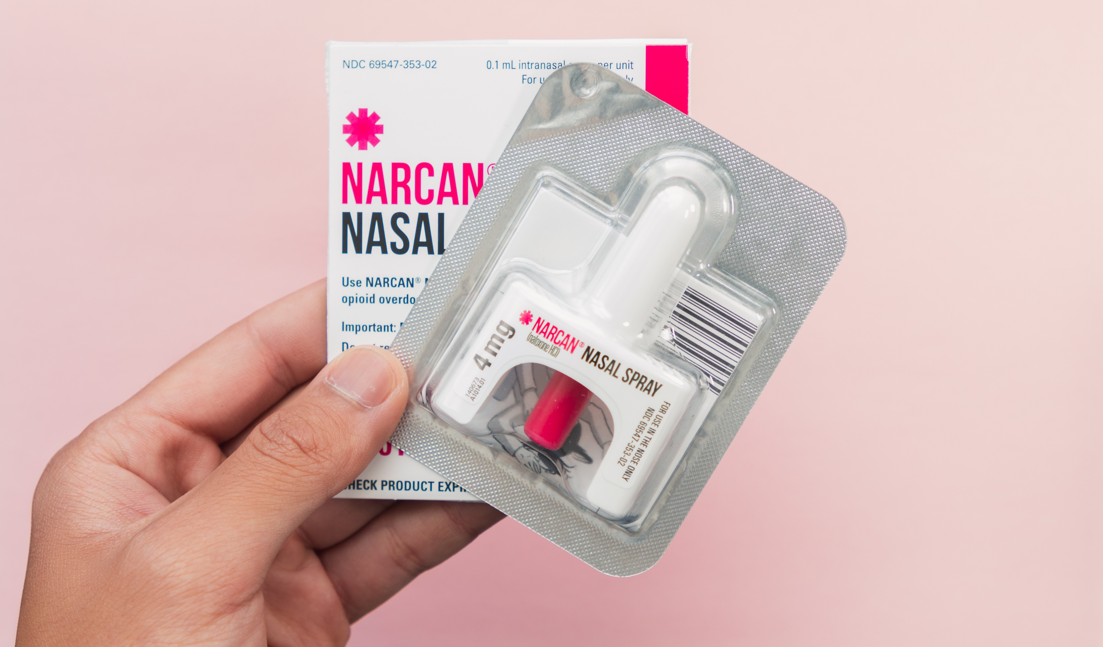
What is Naloxone (Narcan)?
Naloxone is an opioid antagonist that can reverse the effects of an opioid overdose. Usually available as a nasal spray medication.
It works by blocking the effects of opiates on the brain and by restoring breathing. Naloxone will only work if a person has opiates in their system. It does not work for other drug induced overdoses.
There are different brands of Naloxone. Narcan is a “brand” name of Naloxone.
In most states, Naloxone nasal spray can be purchased over the counter at your local pharmacy.

Slide 6
How to administer Naloxone nasal spray?
CDC How to Use Naloxone Nasal Spray Video Link

Slide 7
Signs of an overdose
Signs of an overdose may include:
Not responding or being hard to wake up
Breathing slowly or shallowly
Lips or fingertips turning blue
Very small “constricted” pupils
Pale, sweaty skin
Choking/gurgling sounds
It's important to act fast to save their life.

Slide 8
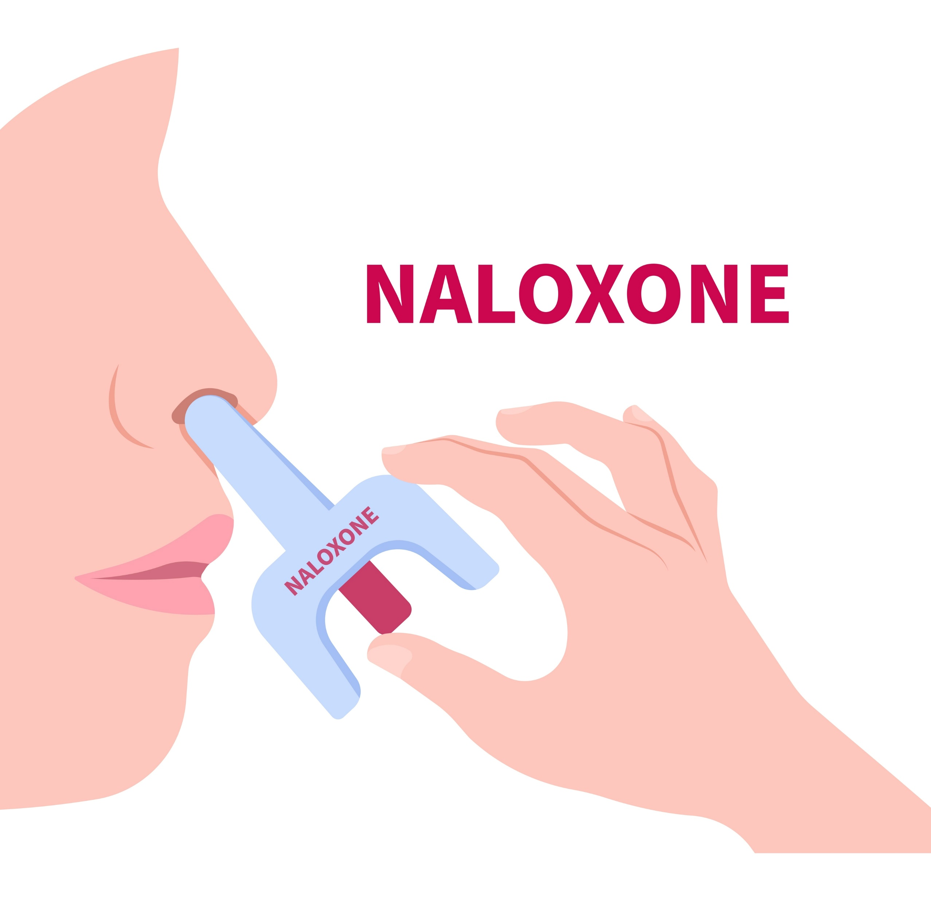
How to respond to an opioid overdose
Call 911
Use Naloxone nasal spray as fast as possible
Try to keep the person awake and on their side.
Provide CPR if needed.
Stay with the person until medical help arrives.

Slide 9
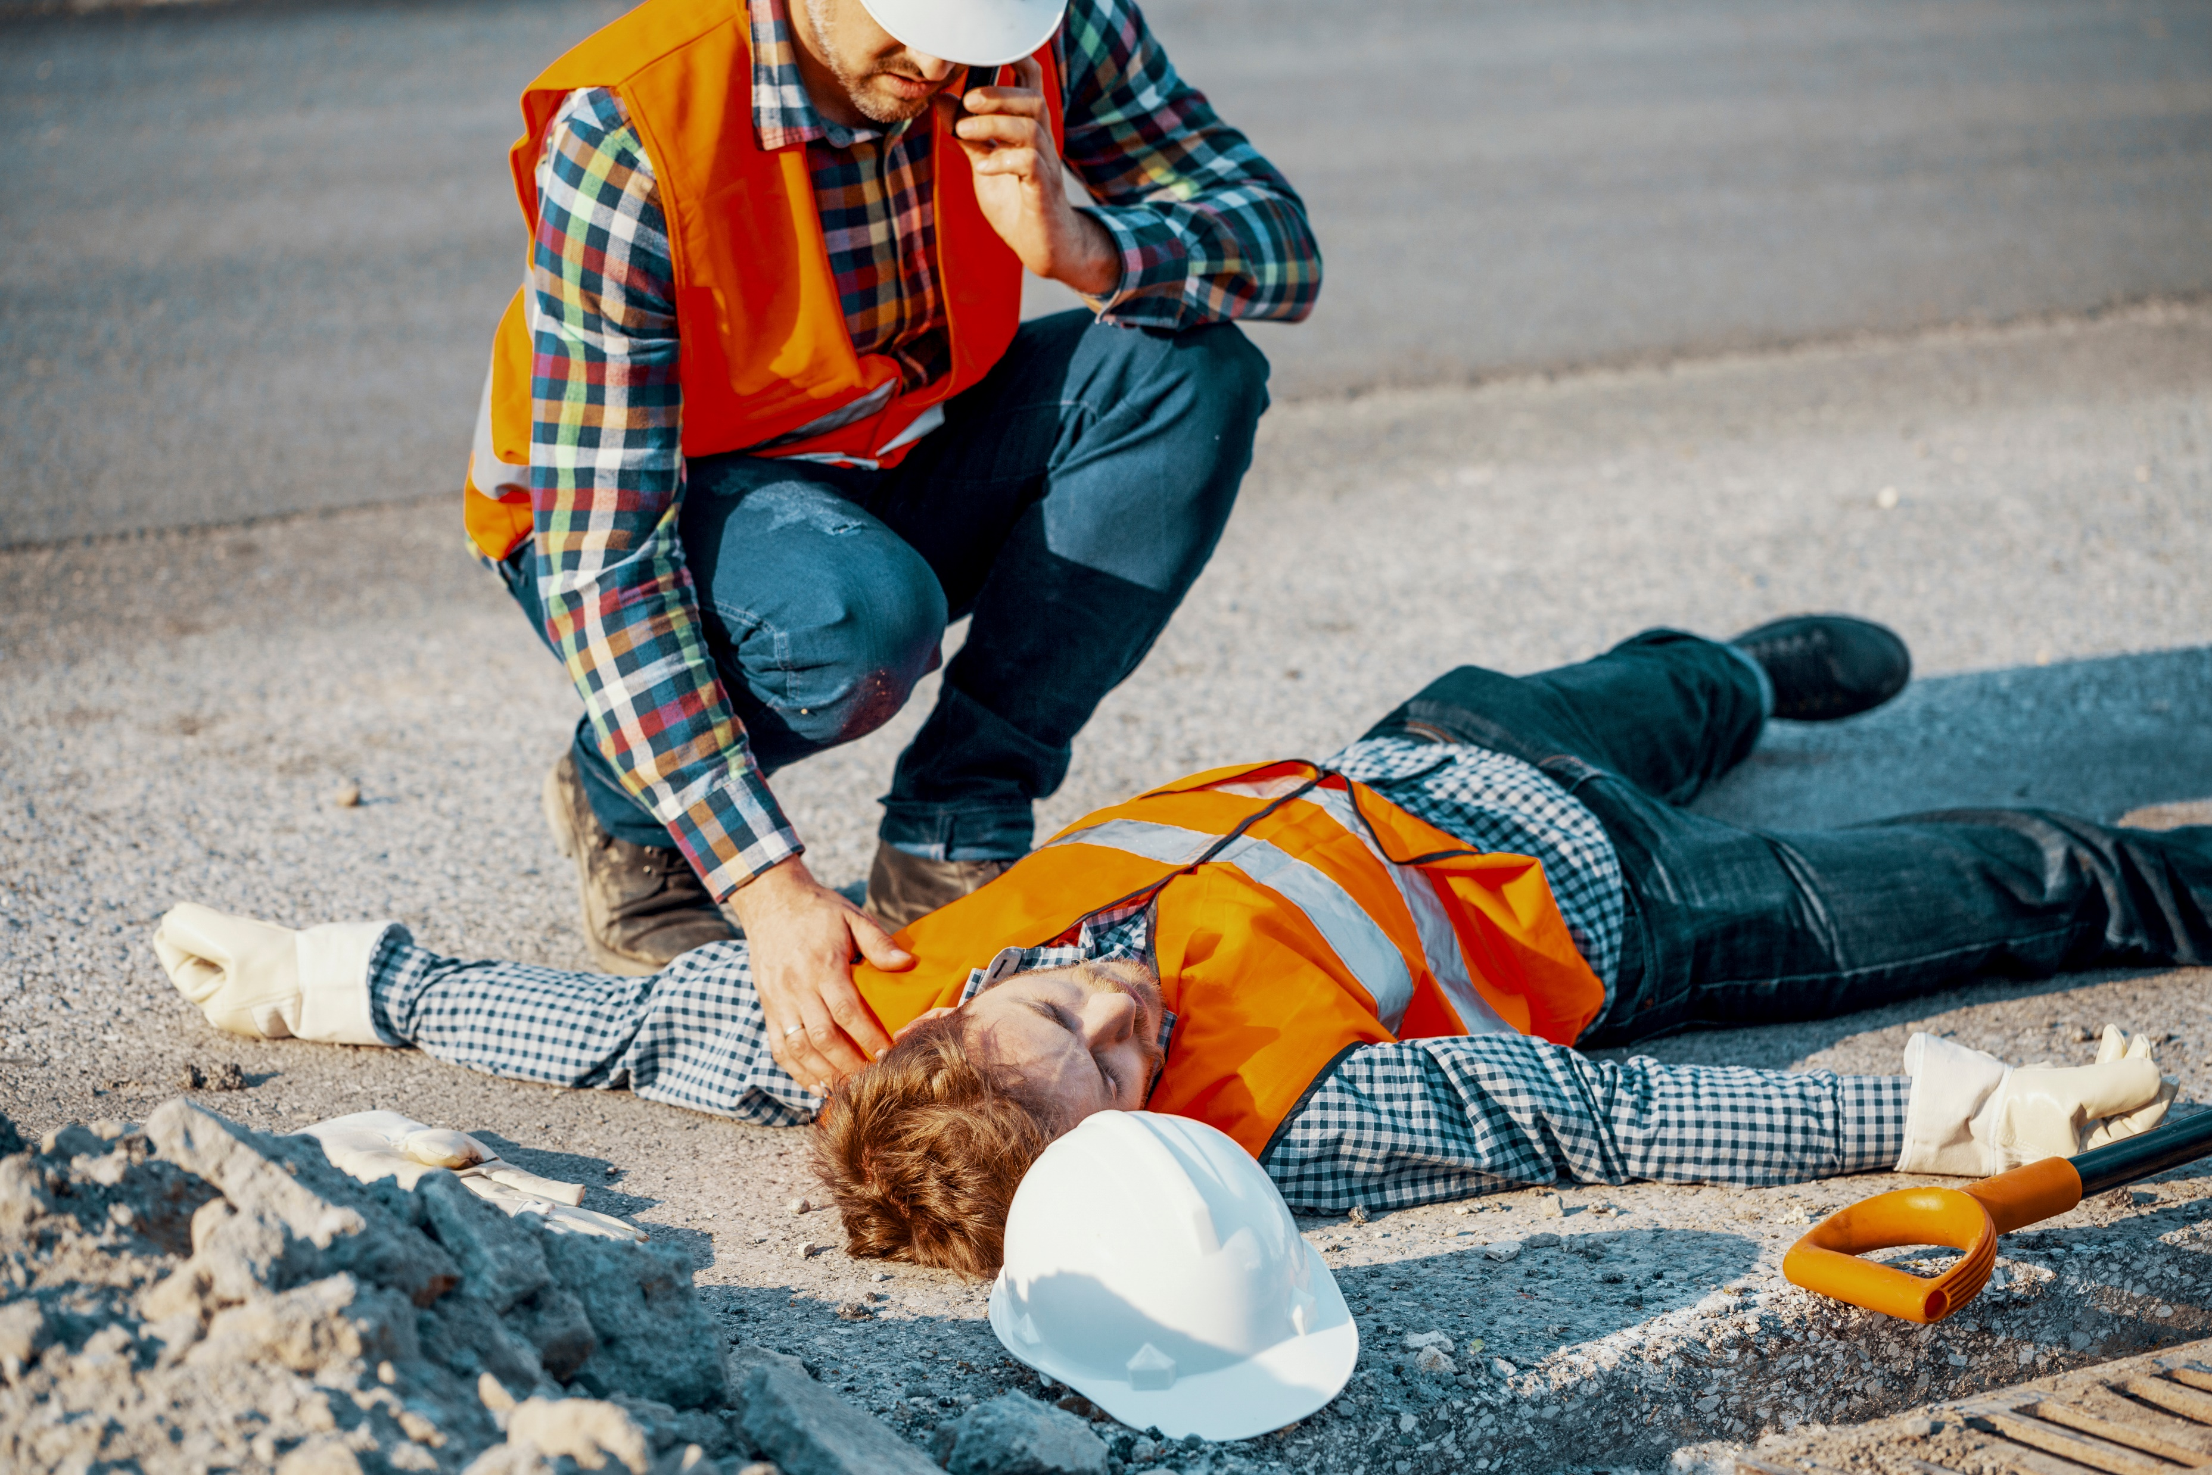
Patient Revival
After a patient wakes up, they may:
Be startled
Be irritated and want to move around or even leave the area
How to help:
Talk to them calmly
Explained what happened

Slide 10
Good Samaritan Laws
Numerous states have enacted Good Samaritan laws designed to safeguard individuals who seek assistance in the event of an overdose.
These statutes may provide legal immunity, even if one possesses drugs at the time of seeking help.
Additionally, they may extend protection to those rendering aid during an overdose. It is advisable to familiarize yourself with the specifics of these laws in your jurisdiction.

Slide 11
Additional Resources
Harmreduction.org - The Harm Reduction Coalition website has lots of information on preventing overdoses.
Safeproject.us - SAFE Project supports people and communities affected by the opioid crisis
Cdc.gov/stopoverdose - The Centers for Disease Control website has detailed info about Naloxone and how to prevent opioid overdoses.

Slide 12
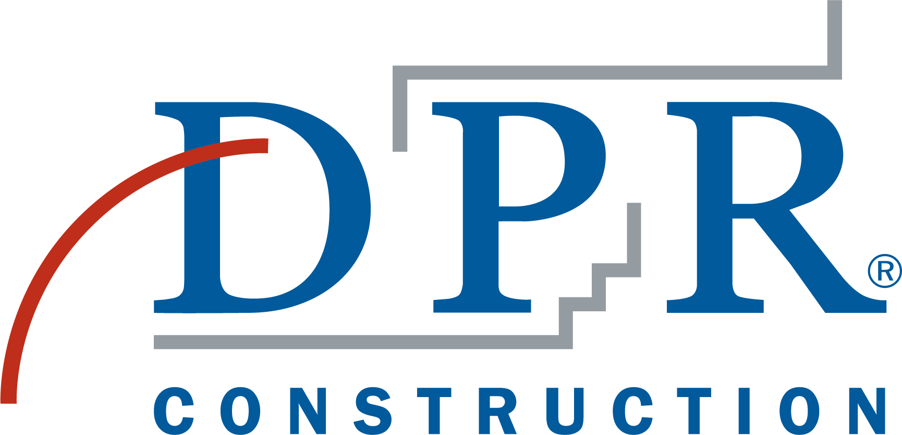
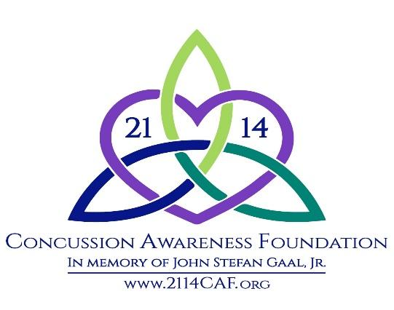
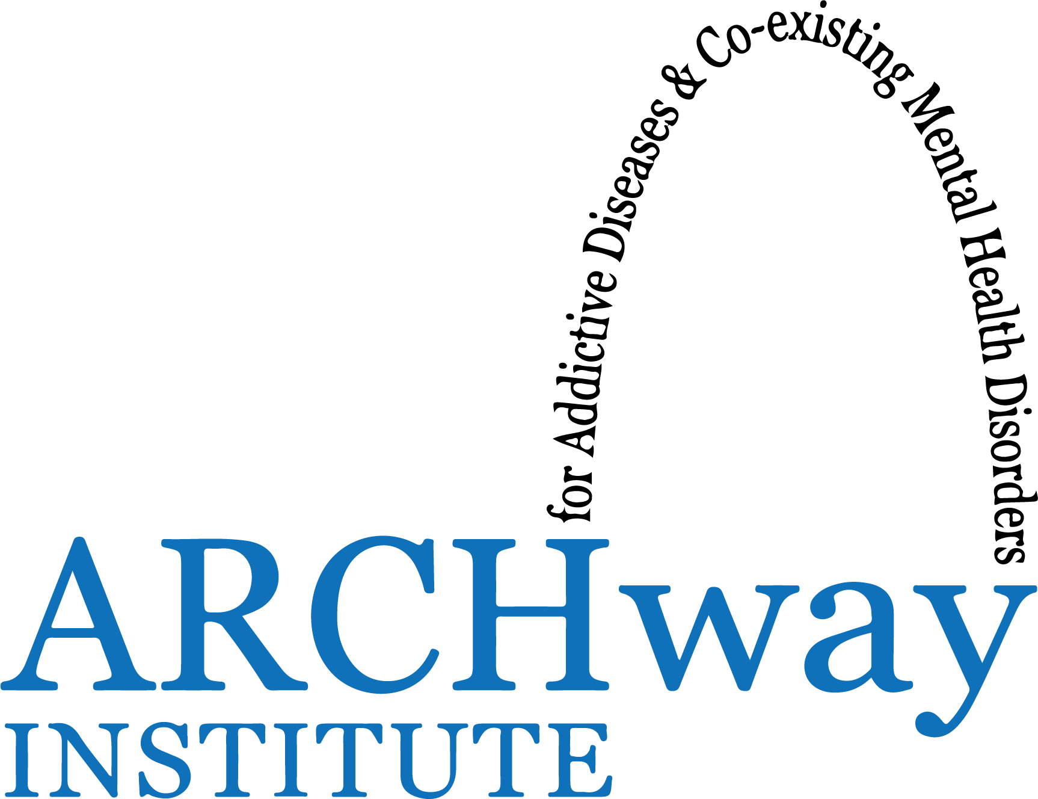
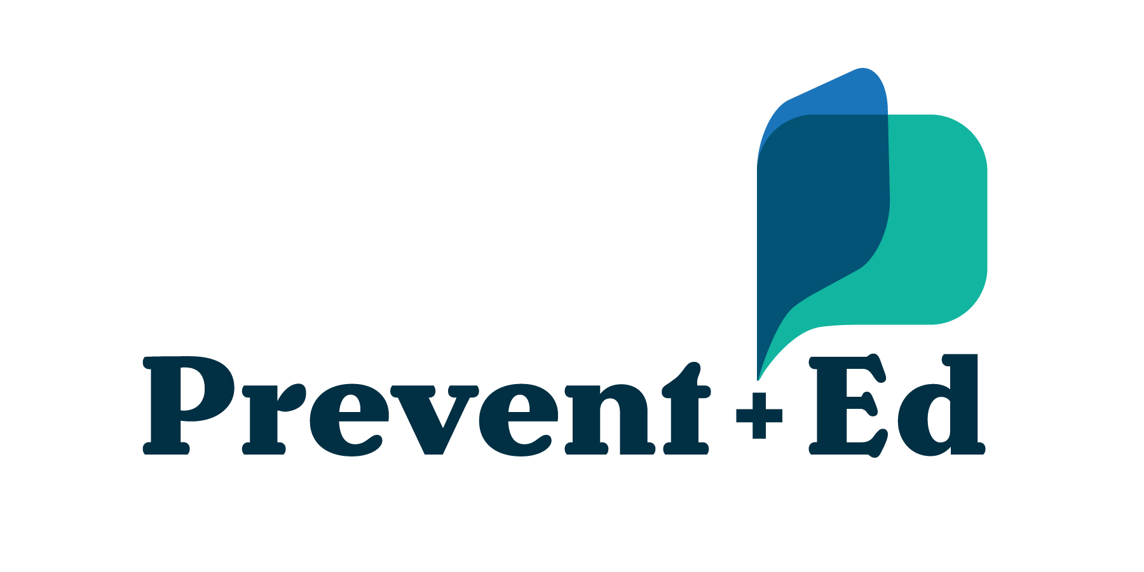
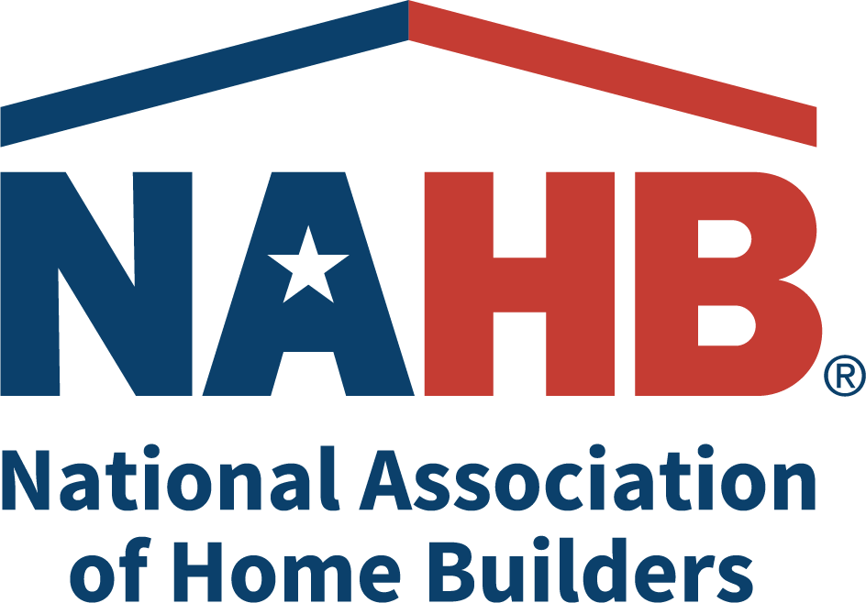
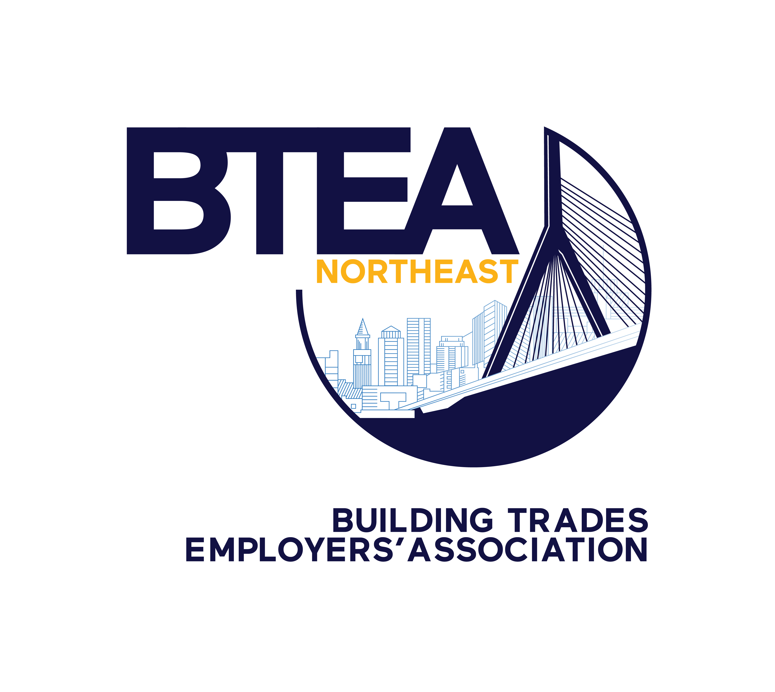
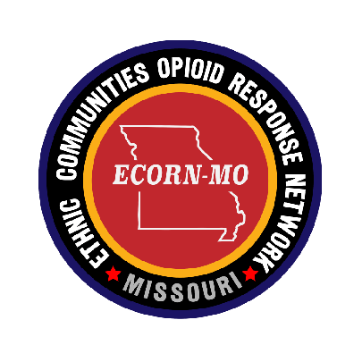
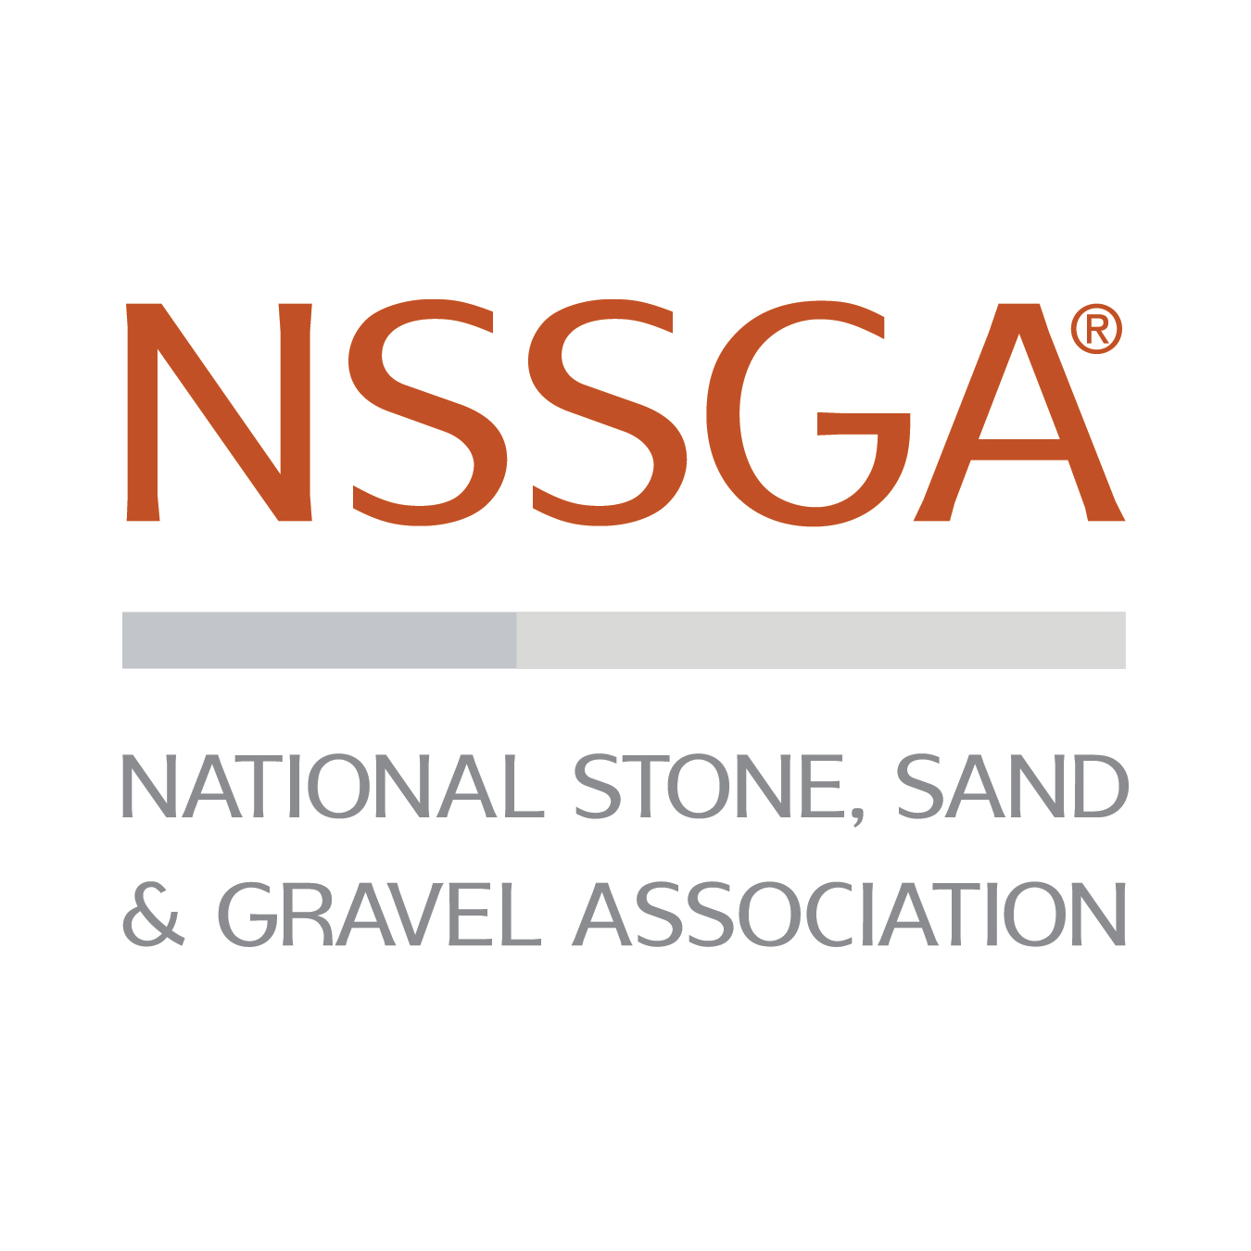
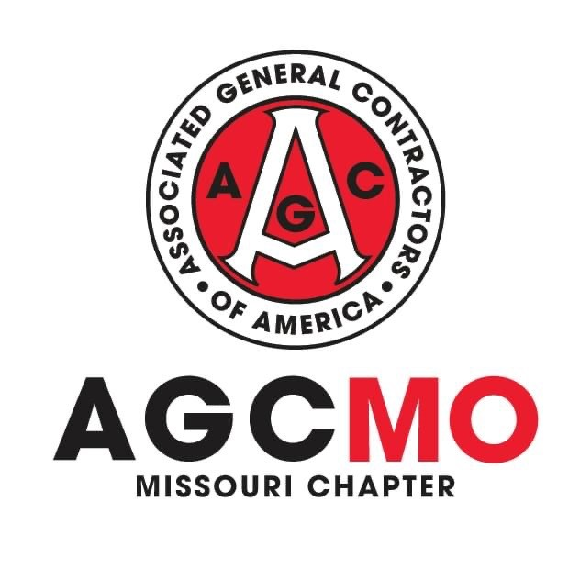
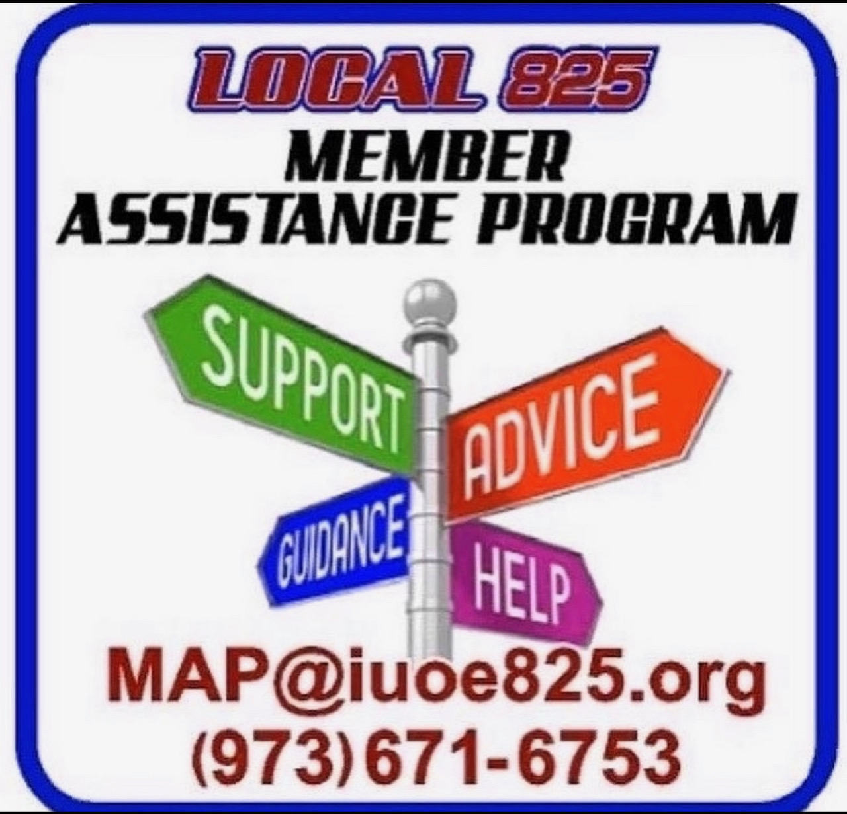
Produced by the The Alliance for Naloxone Safety in the Workplace and it’s founding members.

